Slide 1
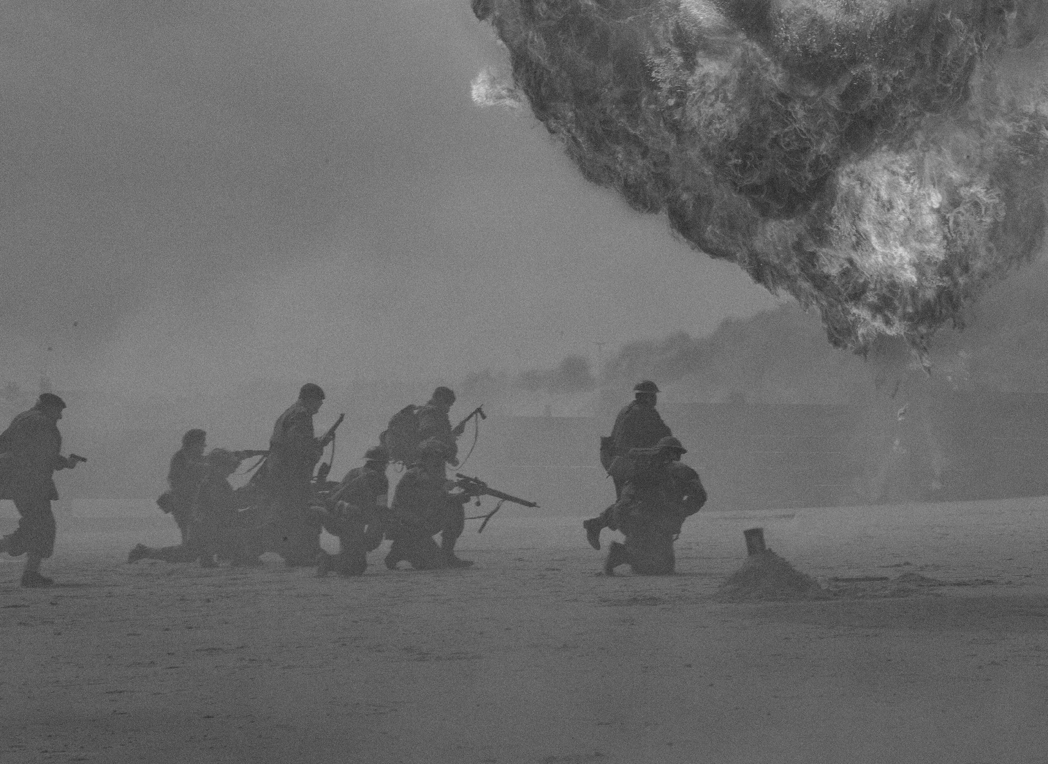

ARMED CONFLICTS AND EVENTS DATA ANALYSIS

Slide 2
Team (Shadow Recruits) Team Members: Sri Sai Abhishake Gopal Dasari – sd4648 Venkata Vyshnavi Ravella - vr2226 Sri Ram Gowd Vuppala – sv2333

Slide 3
PROBLEM STATEMENT
The problem statement is to analyze trends related to armed conflicts like protests, violent activities and other events. This analysis could prove useful to mitigate future armed occurrences as the areas could be categorized and monitored for example, by police and military battalions and to concentrate aid in necessary places.

Slide 4
WHY DOES THIS PROBLEM REQUIRE BIG DATA?
The dataset contains over 1.3 Million records spanning up to 30 columns related to armed conflict events and information like actors involved, date recorded, coordinates, etc.
This would take a very long time for a single machine to perform operations. Considering the stream of real time data from various sources and the complex tasks of running machine learning models motivates to use big data tool kit.
Therefore, we would use big data here, to partition our data, distributing it horizontally and computing these partitioned chunks of data, therefore reducing the time, several fold.

Slide 5
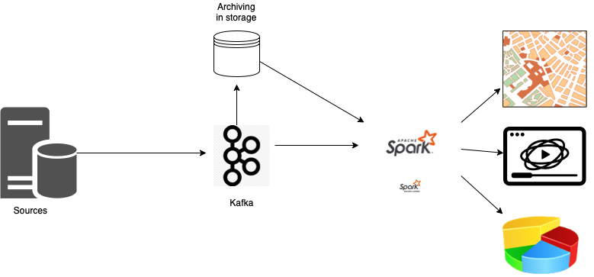
PROPOSED ARCHITECTURE

Slide 6
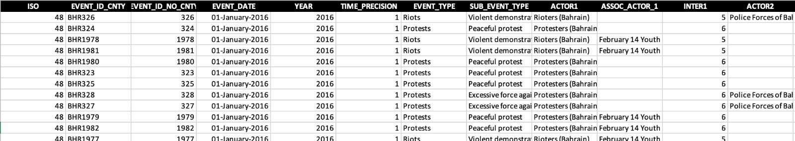
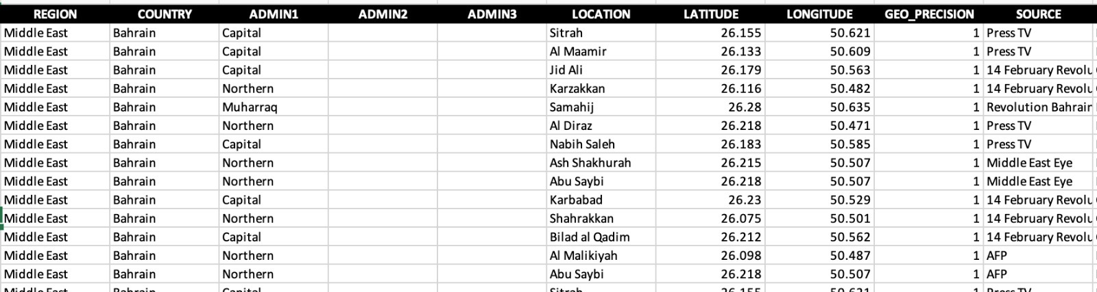
DATASET
Rows
1315502
Columns
31

Slide 7
IMPLEMENTATION
Perform global Exploratory Data Analysis and find out the top countries with most armed violent conflicts.
Performed an in-depth analysis on two countries, here Ukraine and Afghanistan, and obtain stats like fatalities recorded in the recent months in the two countries, due to such armed conflicts.
Visualize the analysis in the form of heatmaps, graphs and pie-charts.

Slide 8
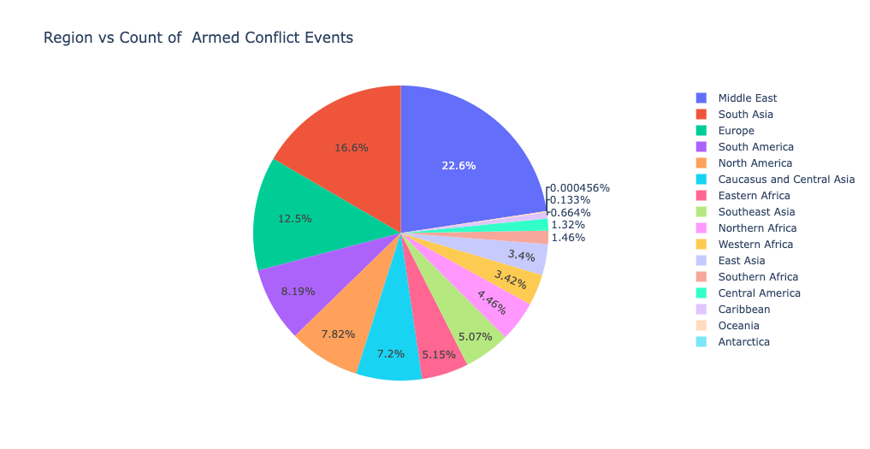
EXPLORATORY DATA ANALYSIS

Slide 9
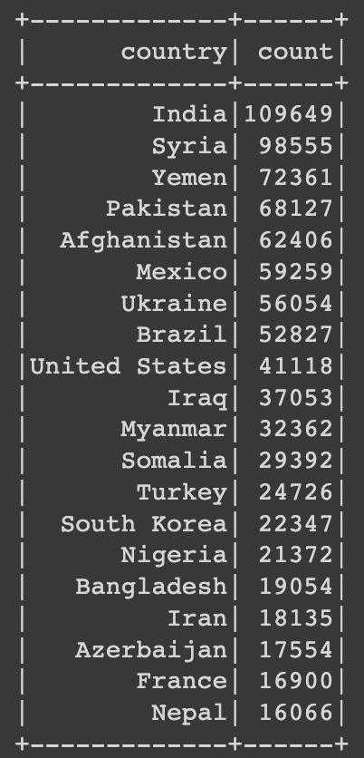
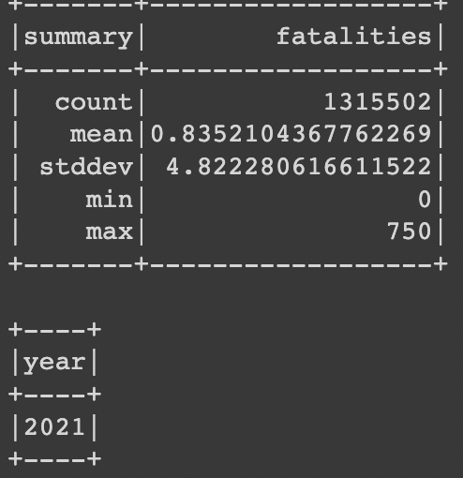
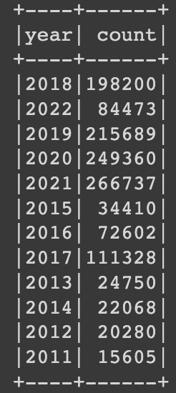
DATA SUMMARY

Slide 10
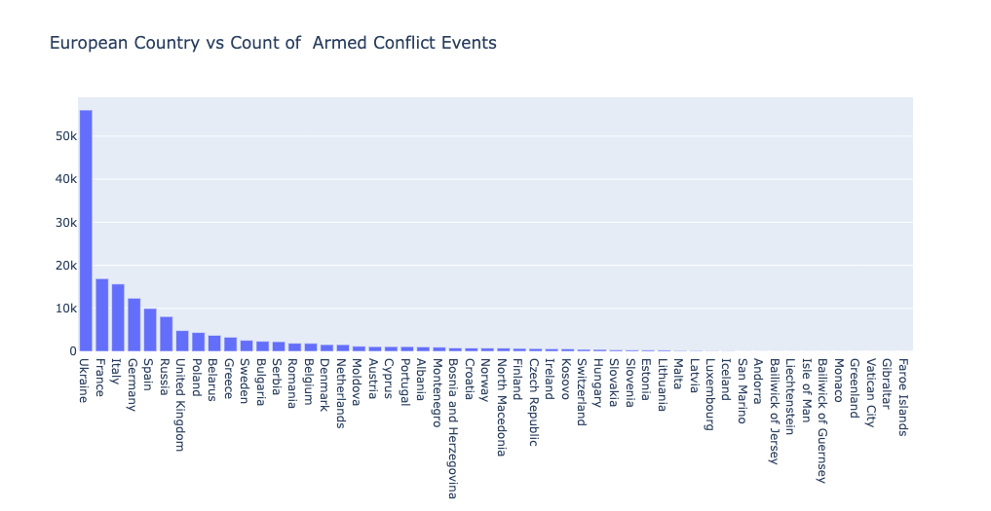
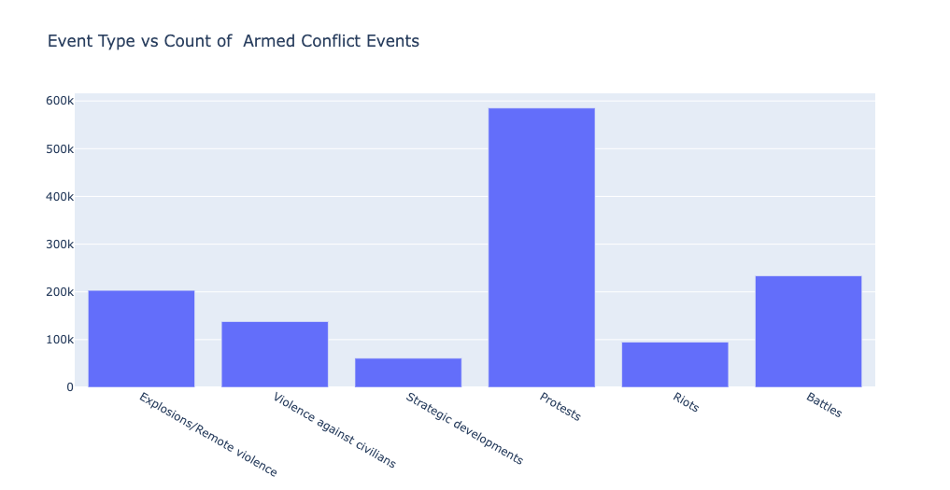
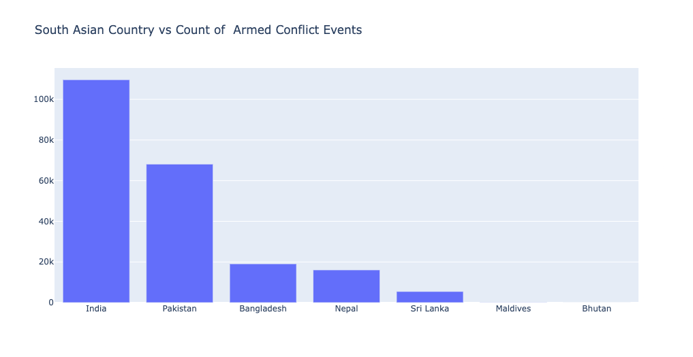

Slide 11
We have chosen to do an in-depth analysis on two countries: Ukraine and Afghanistan. Why?
For two reasons,
Ukraine is facing a lot of military conflict.
Afghanistan is an active conflict country.

Slide 12
Use case I - Ukraine

Slide 13
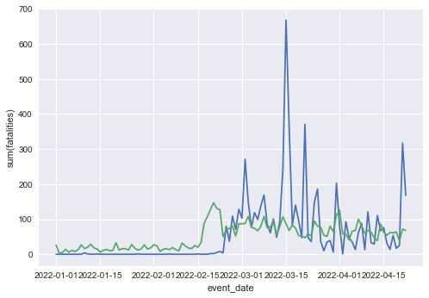
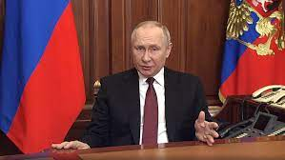
FATALITIES RECORDED - UKRAINE Q1 (2022)
Events Count
Fatalities Count

Slide 14
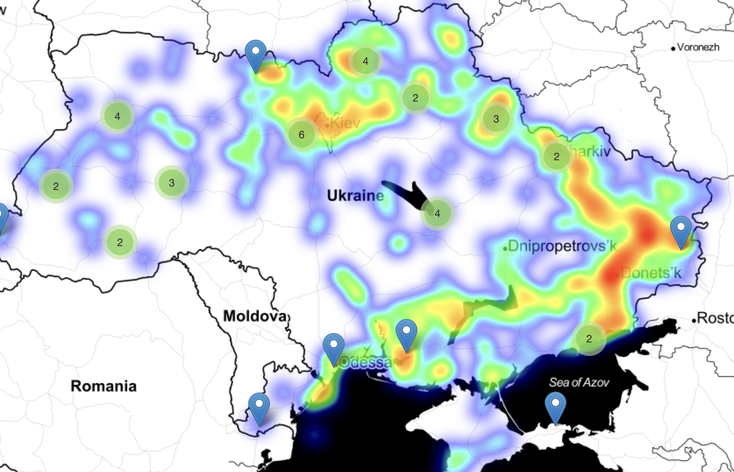
HEAT MAP OF ARMED CONFLICT EVENTS IN UKRAINE

Slide 15
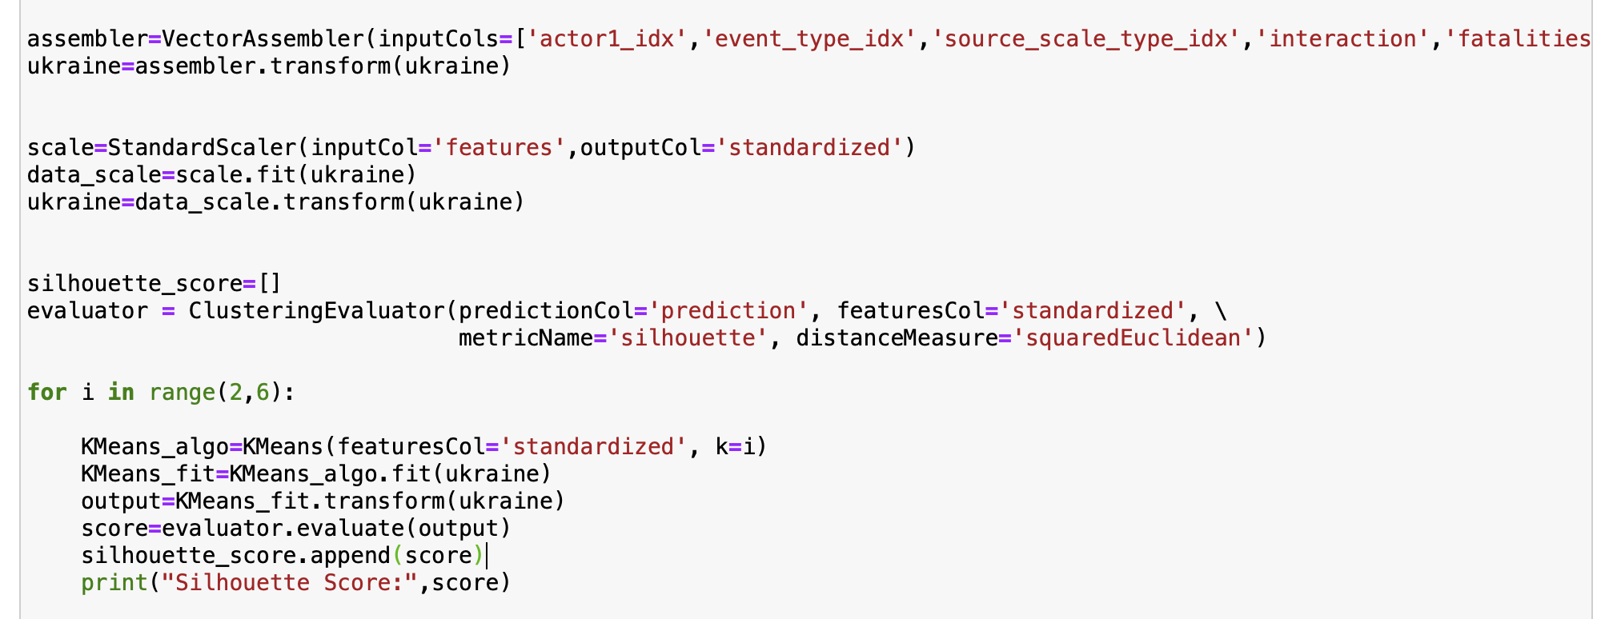
Clustering Events

Slide 16
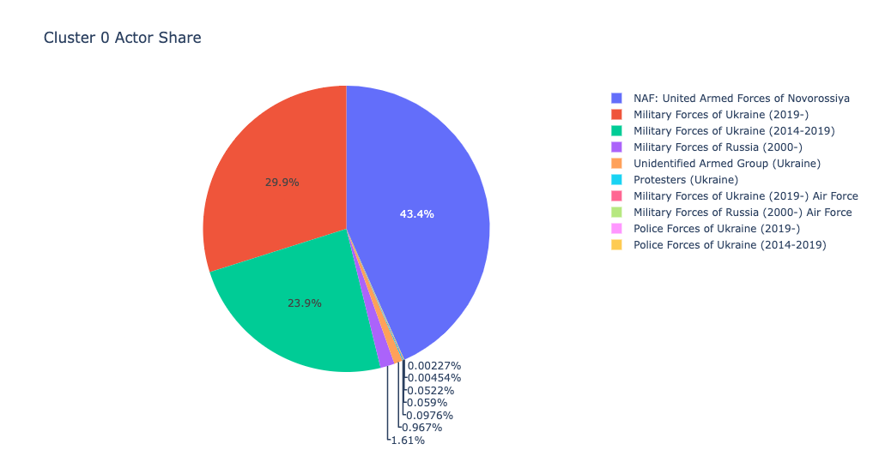
CLUSTERING
Could be Russian Proxies

Slide 17
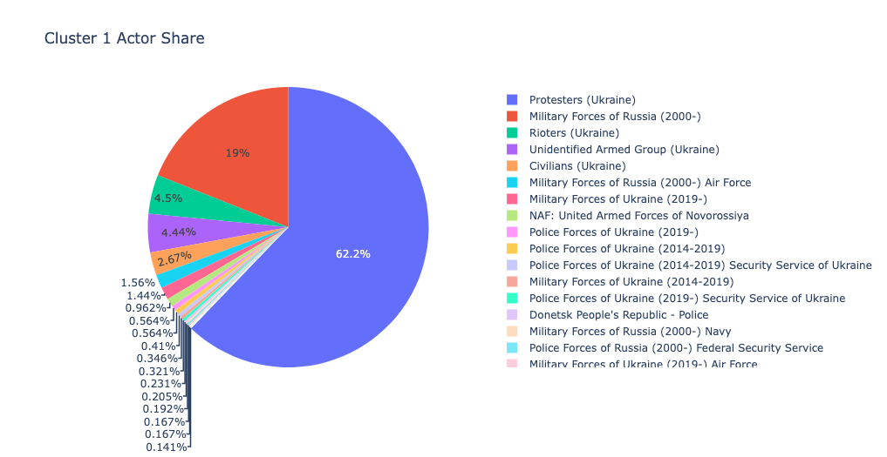
Pro Russian or Anti Russian Protests

Slide 18
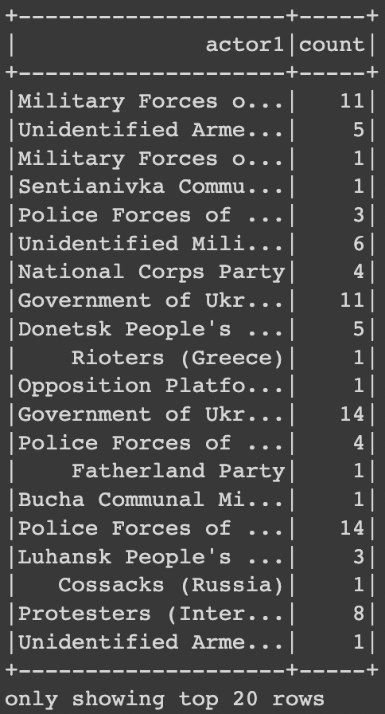
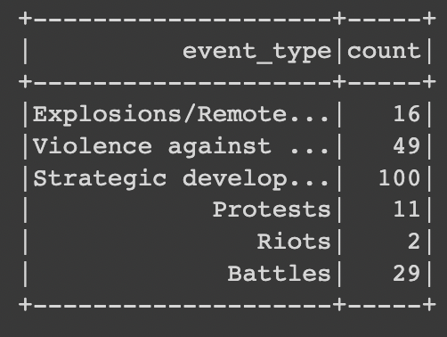
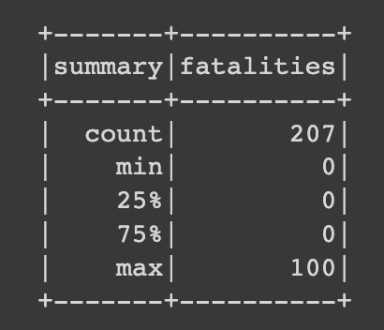
Events misc.
CLUSTER-2

Slide 19
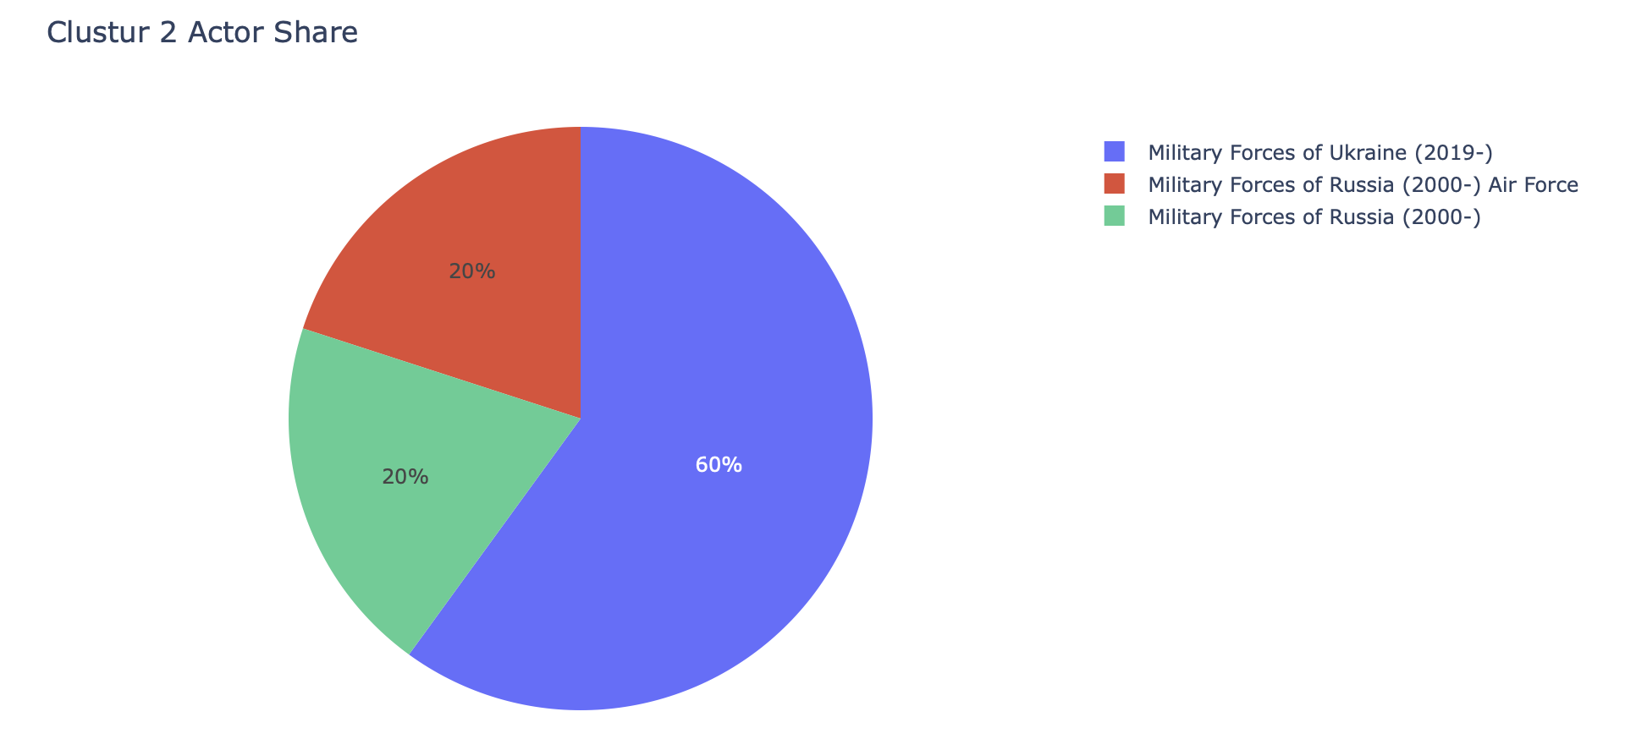
Actual Face Offs

Slide 20
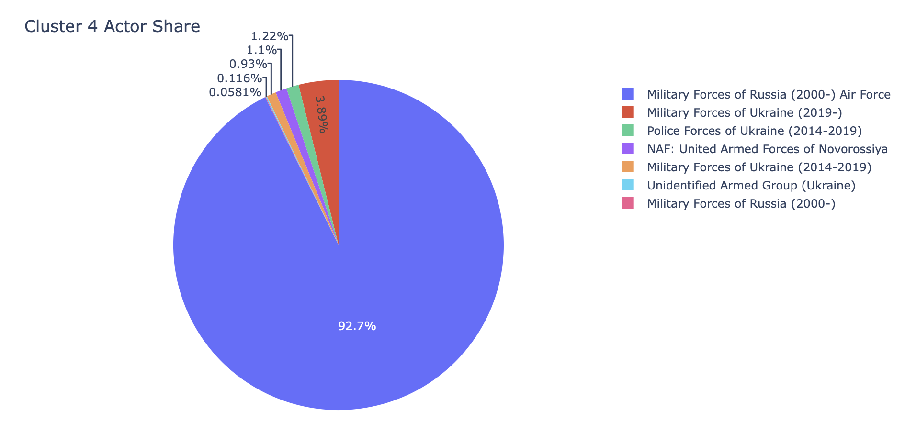
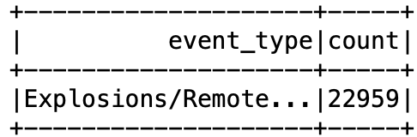
Explosions

Slide 21
Use case 2 - Afghanistan

Slide 22
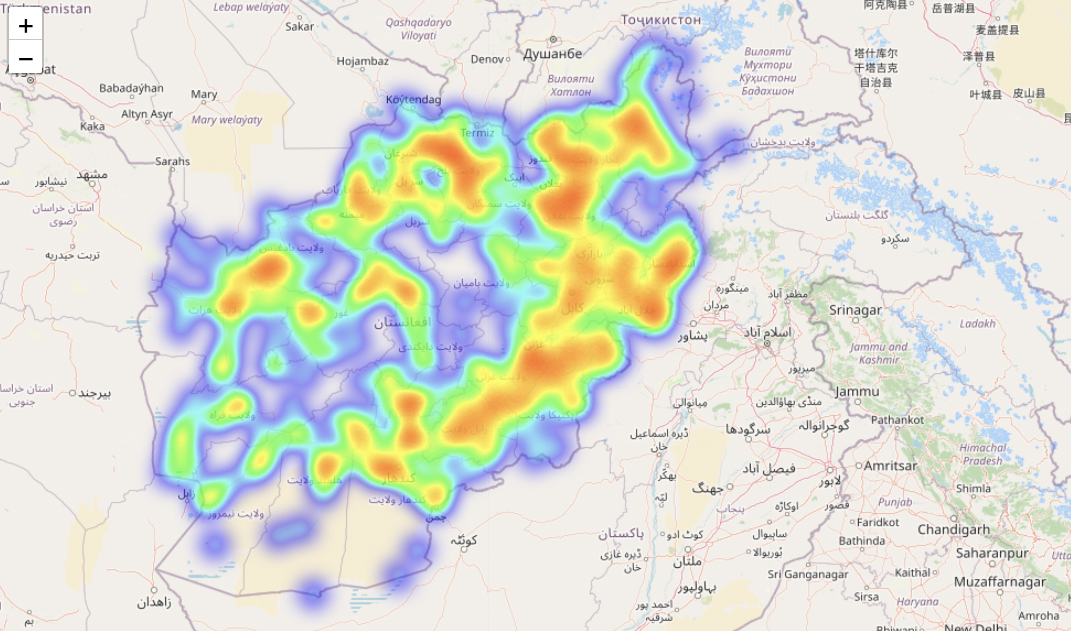
HEAT MAP OF ARMED CONFLICT EVENTS IN AFGHANISTAN

Slide 23
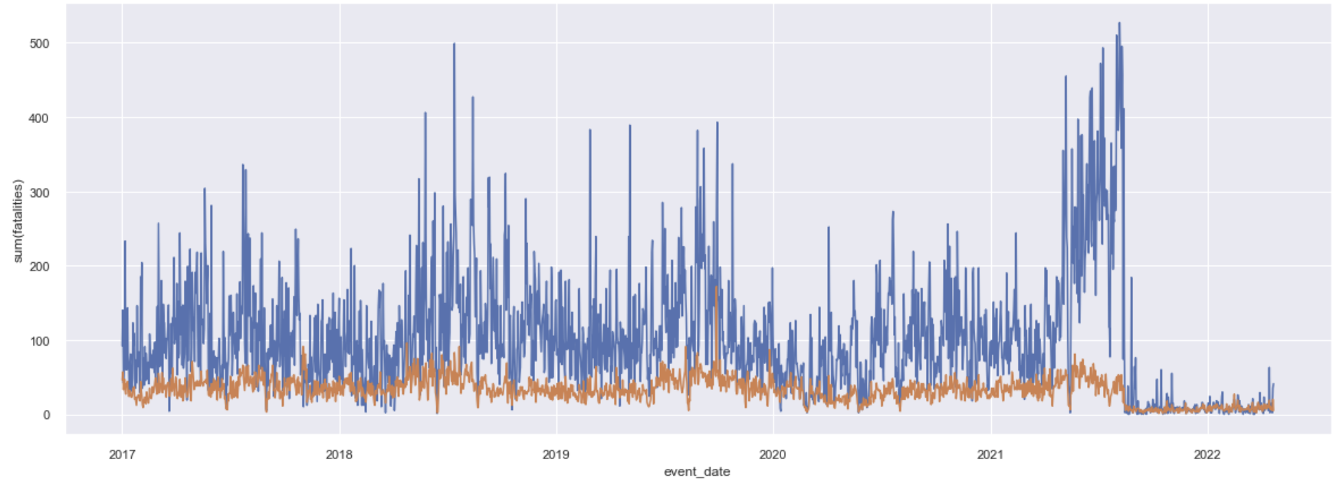
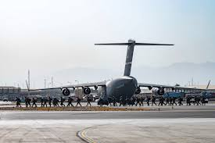
FATALITIES RECORDED- Afghanistan (17-22)
US Withdraws

Slide 24
Can we understand what's happening?

Slide 25
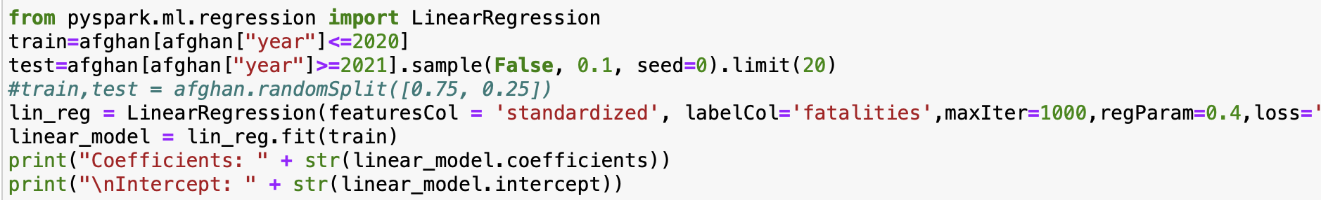
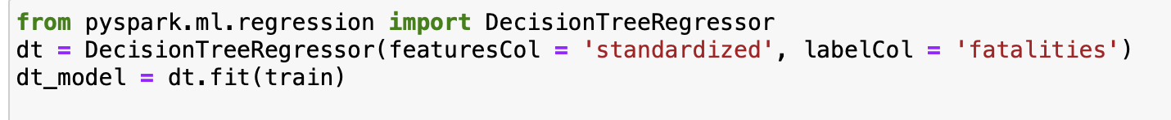
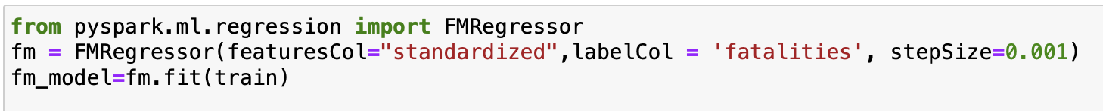
Let's try to Uncover the truth using Regression

Slide 26
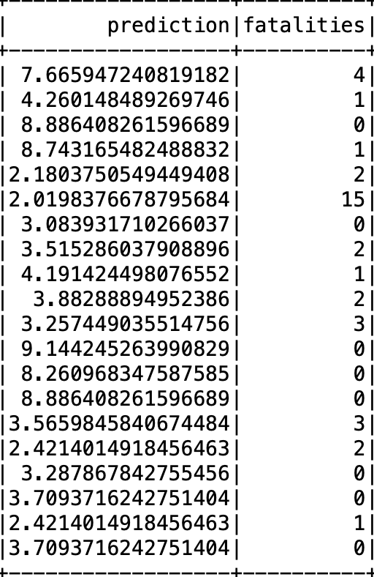
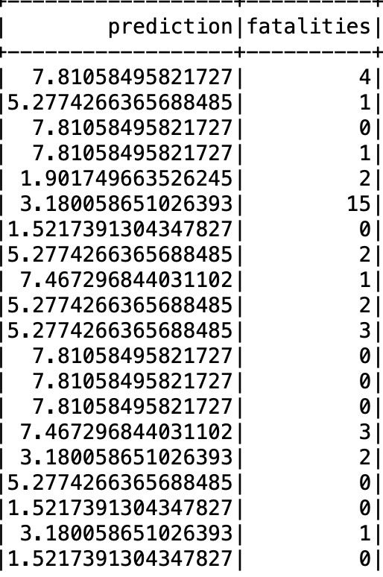
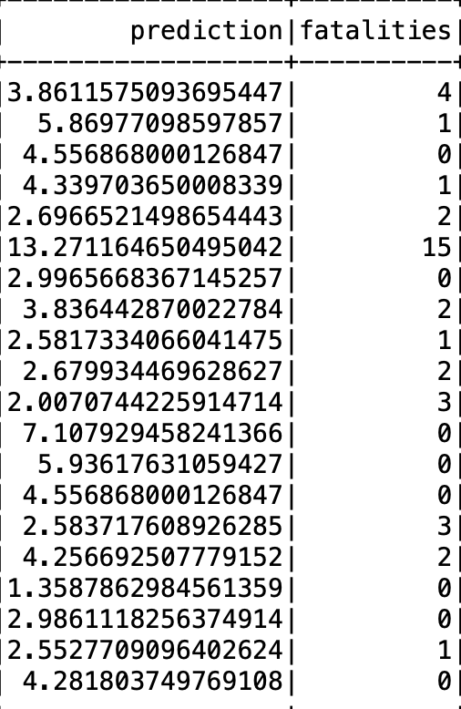
Linear Regressor
Decision Tree Regressor
Factor Machines Regressor

Slide 27
FUTURE SCOPE
The dataset would continue to increase exponentially with the coming years as, violence keeps occurring.
In such cases, big data might be the only possible method of computing in the future as the data cannot be handled by a single machine.
And also, vertically scaling a machine would be futile as well, as the price to performance ratio would not meet the demands.
In future we can include various data sources of twitter, news web scraping to get more data on these kind of armed conflicts.

Slide 28

QUESTIONS?

Slide 29
THANK YOU !

